Slide 1
Women Participation Force
& GDP Growth
Judy Jiang, Aitana Hierro & Virti Sheth

Slide 2

TABLE OF CONTENTS
Part A: Abstract
Part B: Question & Hypothesis
Part C: Dataset Analysis
Part D: Descriptive Statistics
Part E: Baseline Regression Analysis
Part F: Alternative Regression Specification
Part G: Sensitivity Analysis and Limitations
Part H: Conclusion

Slide 3
ABSTRACT
Utilizing data from The World Bank's 2019 dataset, the primary focus is to investigate if the participation of women in the labor force directly influences a country's economic growth over time.
This analysis takes into account various factors including population size, inflation rates, high-technology exports, the proportion of exports to GDP, unemployment rates, the time required to start a business, and the duration of paid maternity leave.
Notes:
This study seeks to uncover a potential cause-and-effect connection between the involvement of women in the workforce and a nation's Gross Domestic Product (GDP) growth.
The study employs GDP growth (annual%) as the key variable of interest, analyzing how changes in female workforce participation rates might lead to fluctuations in a country's economic prosperity.

Slide 4
INVESTIGATION QUESTION & HYPOTHESIS
Does the Participation of Females in the Workforce Cause Changes in a Country's GDP Growth?
"Greater Female Labor Force Participation Positively Influences a Country's Economic Growth and Societal Development."

Slide 5
DATASET ANALYSIS
DEPENDENT VARIABLE
GDP GROWTH
INDEPENDENT VARIABLE OF INTEREST
FEMLABOR
POPULATION
INFLATION
HIGH TECh EXPORTS
EXPORTS
UNEMPLOYMENT
TIME BUSINESS
FMR
DAYSMAYTERNITY
CONTROL VARIABLES
Notes:
1. Dependent Variable: GDP Growth (annual%)
- gdpgrowth: The size of an economy is typically measured by the total production of goods and services in the economy, which is called gross domestic product (GDP)
2. Independent Variable of Interest
- femlabor: Female labor force comprises women ages 15 and older who supply labor for the production of goods and services during a specified period. It includes people who are currently employed and people who are unemployed but seeking work as well as first-time job-seekers. However. Unpaid workers, family workers, and students are often omitted, and some countries do not count members of the armed forces. Labor force size tends to vary during the year as seasonal workers enter and leave.
3. Control Variables (Additional Regressors)
- population: Population, total, which counts all residents regardless of legal status or citizenship. The values shown are midyear estimates.
- inflation: inflation is the Consumer Price Index (CPI), which measures the percentage change in the price of a basket of goods and services consumed by households.
- hightechexp: High-technology exports are products with high R&D intensity, such as aerospace, computers, pharmaceuticals, scientific instruments, and electrical machinery.
- exports: Exports of goods and services represent the value of all goods and other market services provided to the rest of the world. They include the value of merchandise, freight, insurance, transport, travel, royalties, license fees, and other services, such as communication, construction, financial, information, business, personal, and government services. They exclude compensation of employees and investment income and transfer payments.
- unemployment: Unemployment refers to the share of the labor force that is without work but available for and seeking employment.
- timebusiness:. Time required to start a business is the number of calendar days needed to complete the procedures to legally operate a business.
- FMR: Ratio of female to male labor force participation rate is calculated by dividing female labor force participation rate by male labor force participation rate and multiplying by 100.
- daysmayternity:The indicator refers to leave available only to the mother for the birth of a child to be taken just before, during and immediately after childbirth.

Slide 6
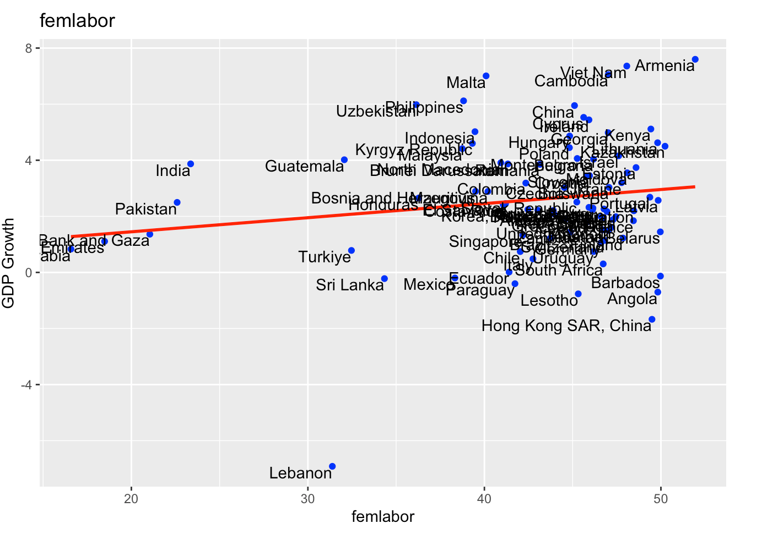
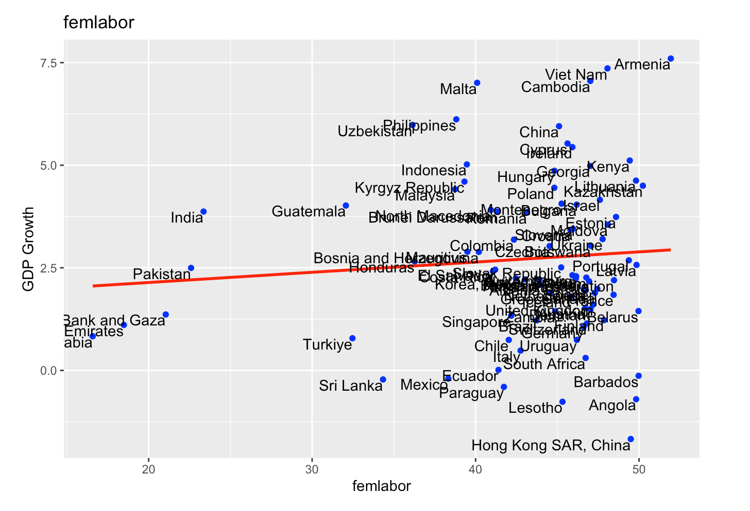
SCATTERPLOT
Notes:
Looking at the Scatterplot it seems that Female Labor and GDP Growth have a weak positive relationship, meaning that when the ratio on Female Labor increases, the GDP Growth slightly increases. This weak increase is relevant, because even a small GDP Growth means a lot for a country's economy. From this graph we can also easily spot an outlier, in this case it represents Lebanon with a decrease of more than -6 on GDP and a little bit more than 30% of the workforce being female. Lebanon in 2019 went through a Revolution in 17 October of 2019, which caused their government to resign. This is a factor that leads us to decide to keep the outlier out of the analysis.

Slide 7
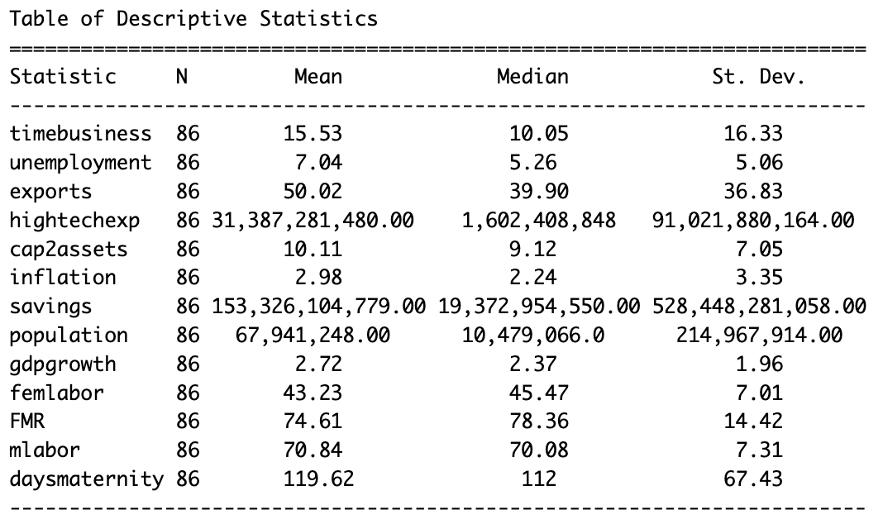
DESCRIPTIVE STATISTICS
Notes:
- The mean for **GDP Growth** is higher than the median, which suggests that the distribution for this variable is right-skewed, meaning that most of the data is clustered around the left tail of the distribution while the right tail of the distribution is longer. Also, the standard deviation is lower than the mean, which suggests small spread in the data.
- The mean for **Female Labor** is lower than the median, which suggests that the distribution for this variable is left-skewed, meaning that most of the data is clustered around the right tail of the distribution while the left tail of the distribution is longer. Also, the standard deviation is lower than the mean, which suggests small spread in the data.

Slide 8
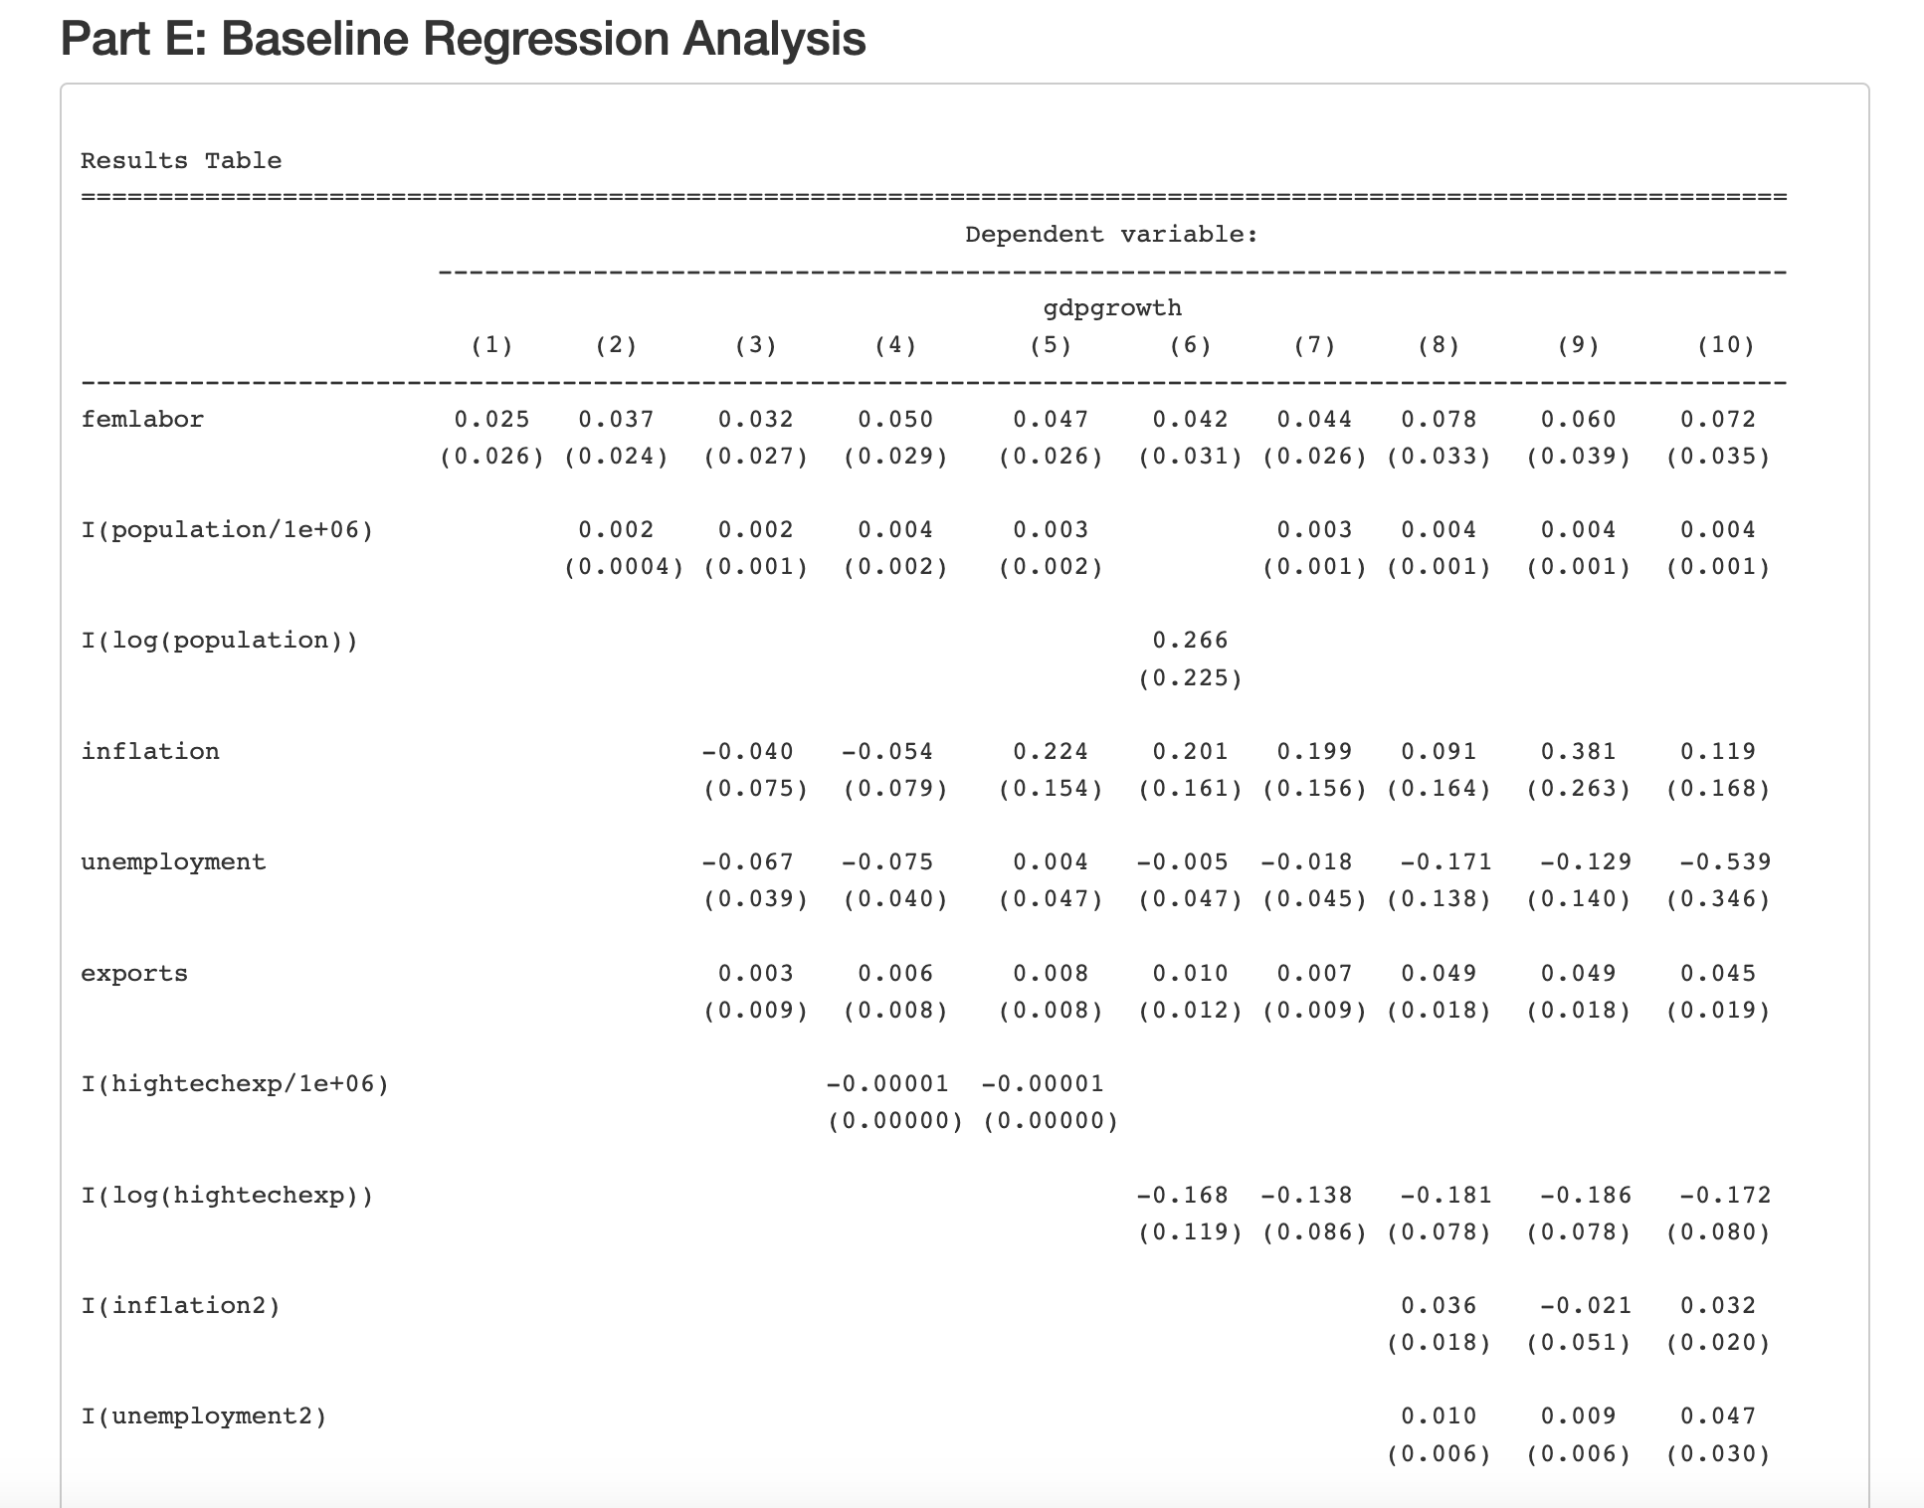
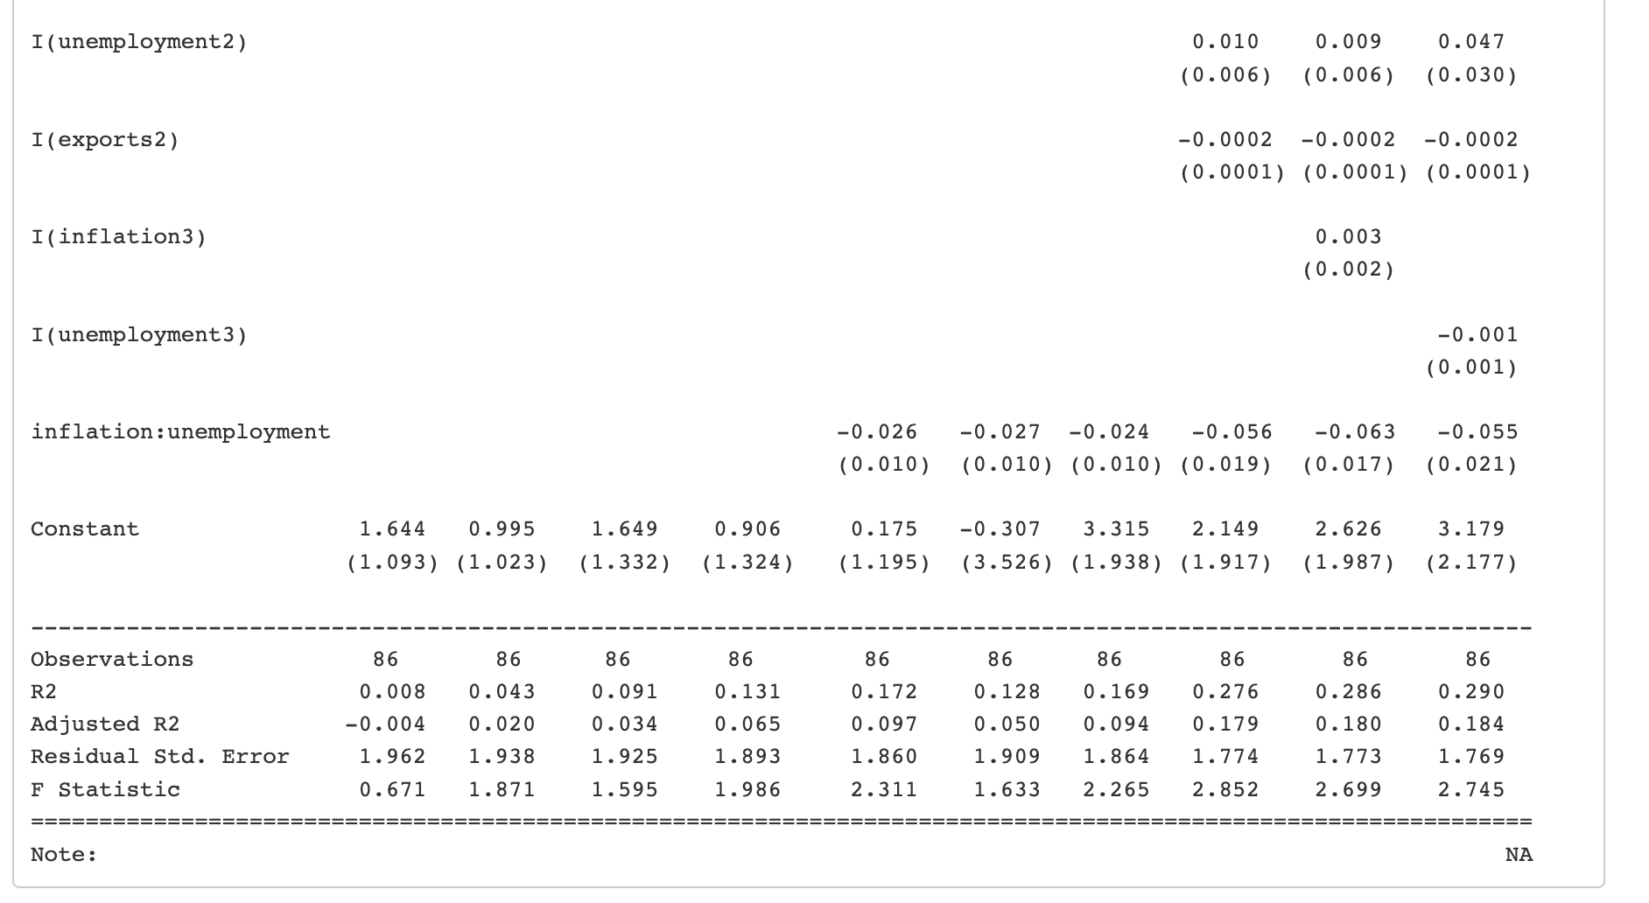
BASELINE
REGRESSION
ANALYSIS

Slide 9
BASELINE REGRESSION SUMMARY
From Regression 1 to 5 we added the interest variables and other control variables into the regressions step by step.
We did NOT get statistical significance in any of the models.

Slide 10
BASELINE REGRESSION SUMMARY
In Regressions 6 and 7 we tested the use of logs on the variables population and high tech exports,
This did NOT have an effect in achieving statistical significance on the variable of interest.

Slide 11
BASELINE REGRESSION SUMMARY
Lastly, we tested for other non-linearities in Regressions 8 to 10.
We used a quadratic approach on Regression 8 for the variables inflation, unemployment, and exports and we achieved statistical significance for the variable of interest.
In Regressions 9 and 10 we included inflation cube and unemployment cube, respectively. We achieved statistical significance on the variable of interest in Regression 10.

Slide 12
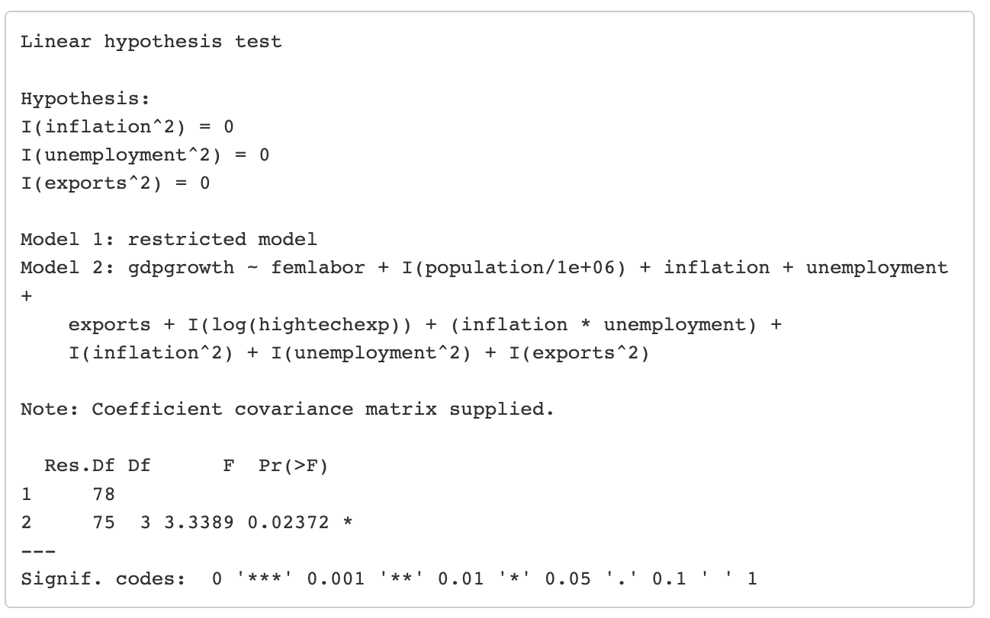
BASELINE MODEL SELECTION: F TEST 1
REGRESSION 7
VS
REGRESSION 8

Slide 13
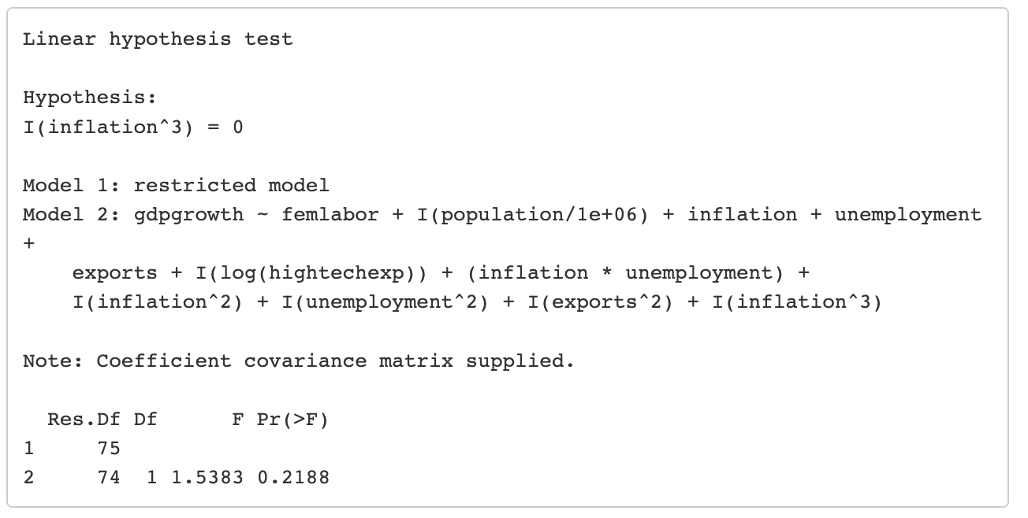
BASELINE MODEL SELECTION: F TEST 2
REGRESSION 8
VS
REGRESSION 9

Slide 14
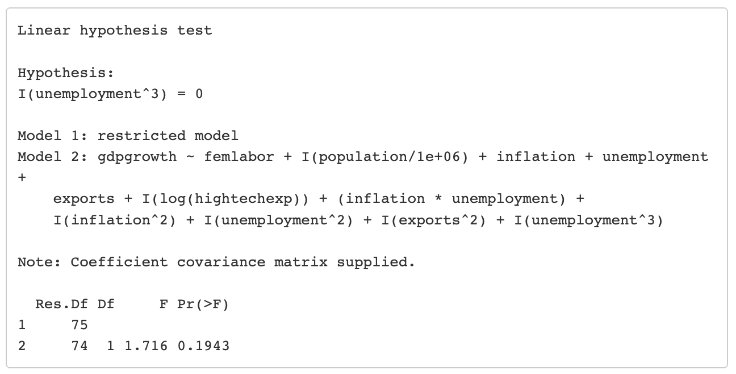
BASELINE MODEL SELECTION: F TEST 3
REGRESSION 8
VS
REGRESSION 10

Slide 15
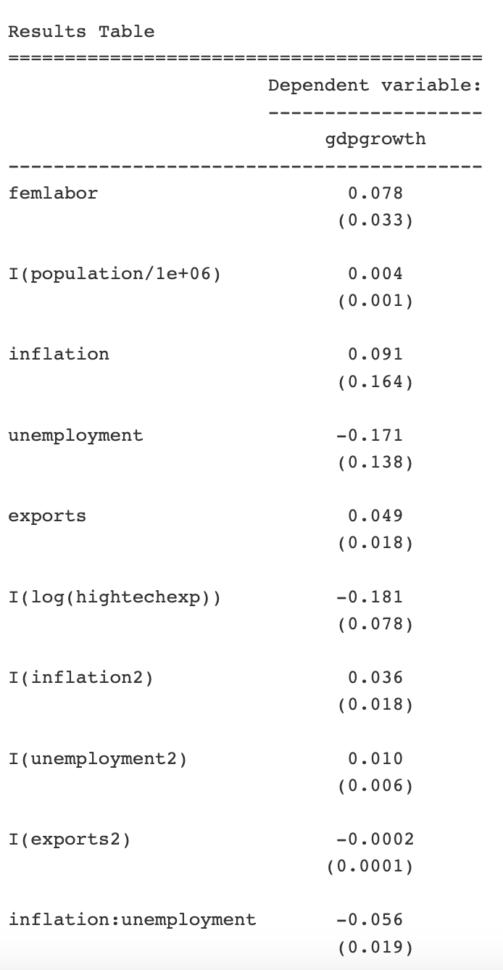
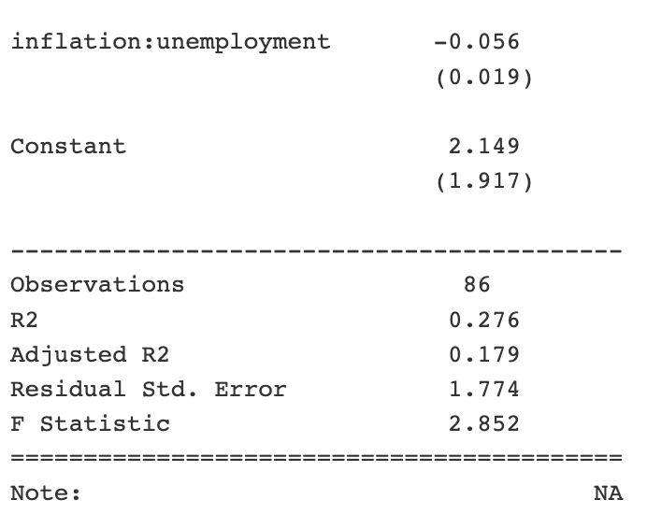
CHOSEN BASELINE
REGRESSION

Slide 16
ALTERNATIVE REGRESSION ANALYSIS
The spread of the data is not enough, it’s not reasonable to change female labor force participation rate into two-group dummies.

Slide 17
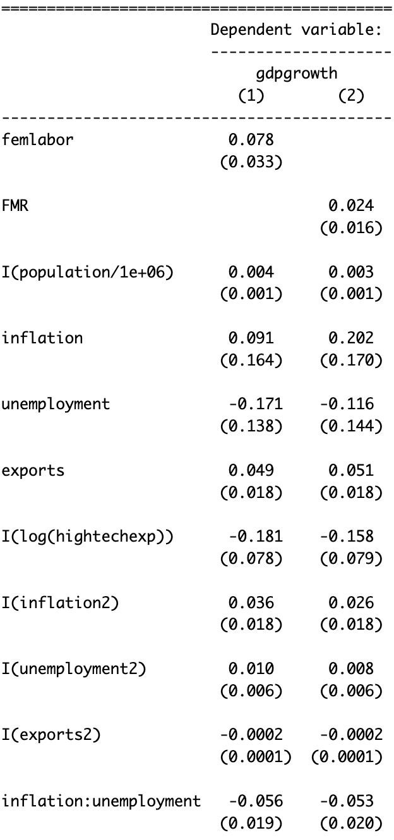
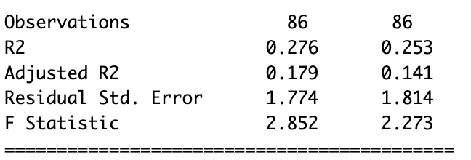
ALTERNATIVE REGRESSION ANALYSIS
How can we test the strength of FEMALE to GDP growth comparing with MALE?
Femlabor = Female Labor Force / Overall labor force
FMR = (FemaleLabor /overall) / (MaleLabor / overall )
Holding other factors constant, increasing FMR by 1%, GDP growth increase 0.027%
FMR increase 1%: Relatively increase in female labor force.

Slide 18
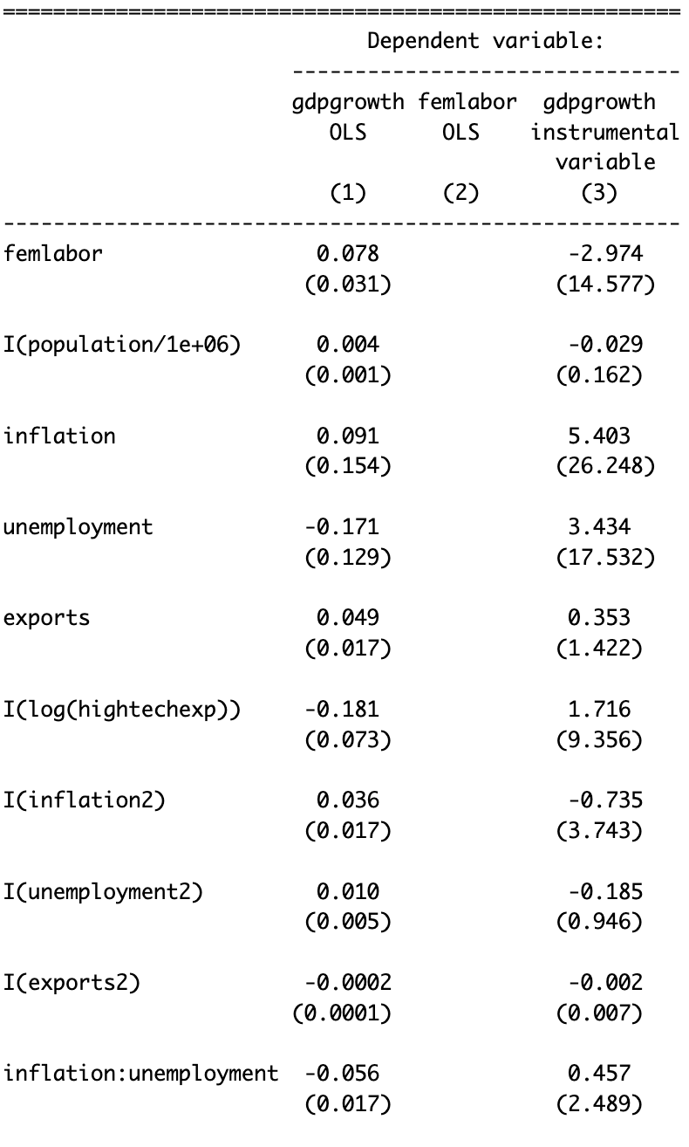
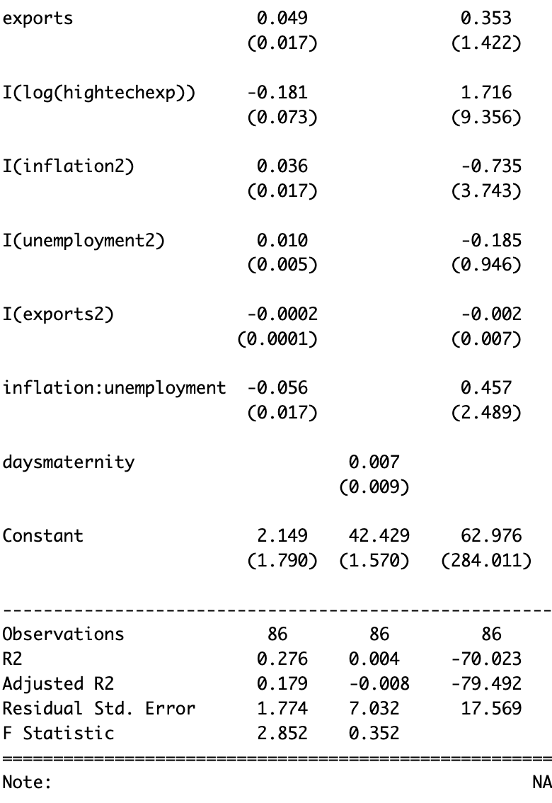
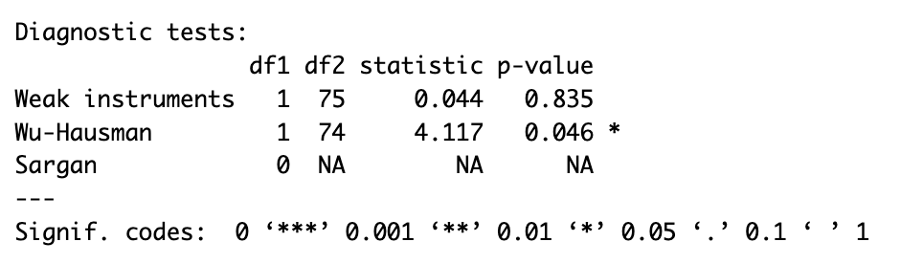
ALTERNATIVE REGRESSION ANALYSIS
Instrumental variable: Length of paid maternity leave (calendar days)
It is a weak instrument
It is exogenous. This model is not consistent with OLS

Slide 19
SENSITIVITY ANALYSIS
AND LIMITATIONS
1. Internal Validity
- Omitted Variable Bias
- Endogeneity
2. External Validity
- Generalizability
- Timeframe

Slide 20
CONCLUSION
What is the causal effect of the Female Labor Force on GDP Growth?
The report explored if there exists a causal relationship between female labor force participation and a country's GDP growth.
The evidence indicates a positive correlation, suggesting that higher female workforce engagement may contribute to economic advancement. The findings from the investigation align with our hypothesis

Slide 21
CONCLUSION
What is the causal effect of the Female Labor Force on GDP Growth?
However, establishing a direct causal relationship demands further nuanced exploration considering the complex interplay of economic, social, and policy factors because we had 14 different regressions testing for different variables and in all of the cases there has been a positive relationship between ‘Female Labor’ and ‘GDP Growth’, but this relationship was not always statistically significant.

